Slide 1

AIML Group Lab Team 4
Drought Management System
Help streamline Government effort to reduce time to action

Slide 2
Agenda
Problem Statement
Introduction to Team
Response to the Questionnaire (Refer Abstract)
Business Applications, Post course
Q & A

Slide 3
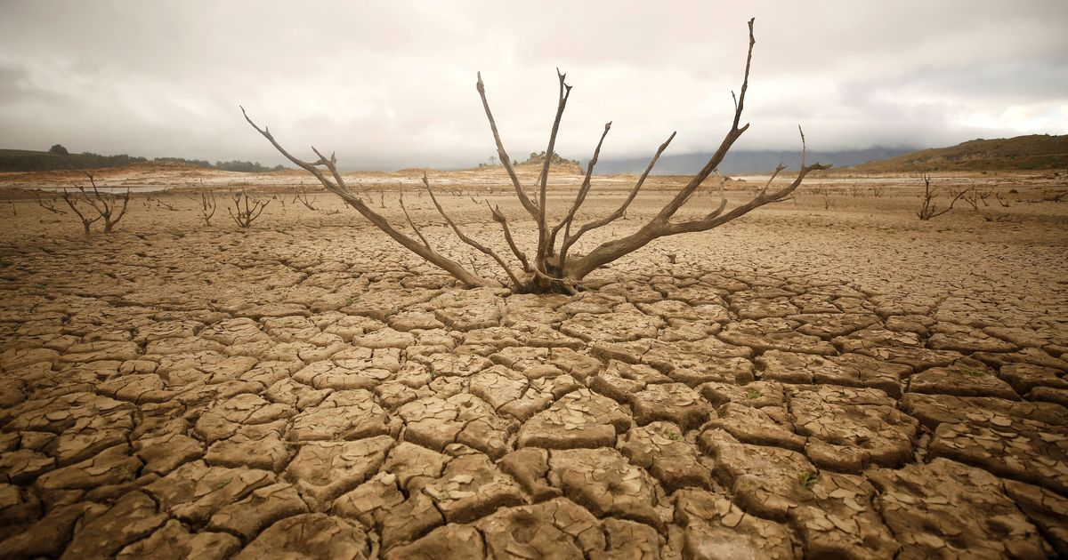
Problem Statement
One of the biggest unavoidable challenges in agriculture sector are the natural calamities like Drought, Flood, etc. In that context Drought management is a huge problem in India today. Its impact is a huge irrecoverable loss ranging from farmer distress to suicides.
Problem: The government has limited resources and time to handle the stressful situations like drought in a highly populated countries like India.
Solution: We provide a solution to this problem by classifying the villages in different clusters from ‘not impacted’ to ‘severely impacted’ by using our models so that government can prioritize their resources & reduce time to action.
Impact: Our solution has huge impact in reducing farmer distress and suicidal rates. It also helps in optimal usage of government resources with a deep socio-economic impact.

Slide 4
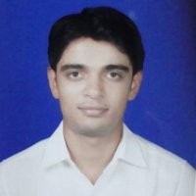
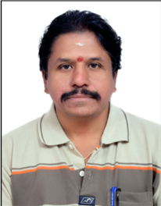

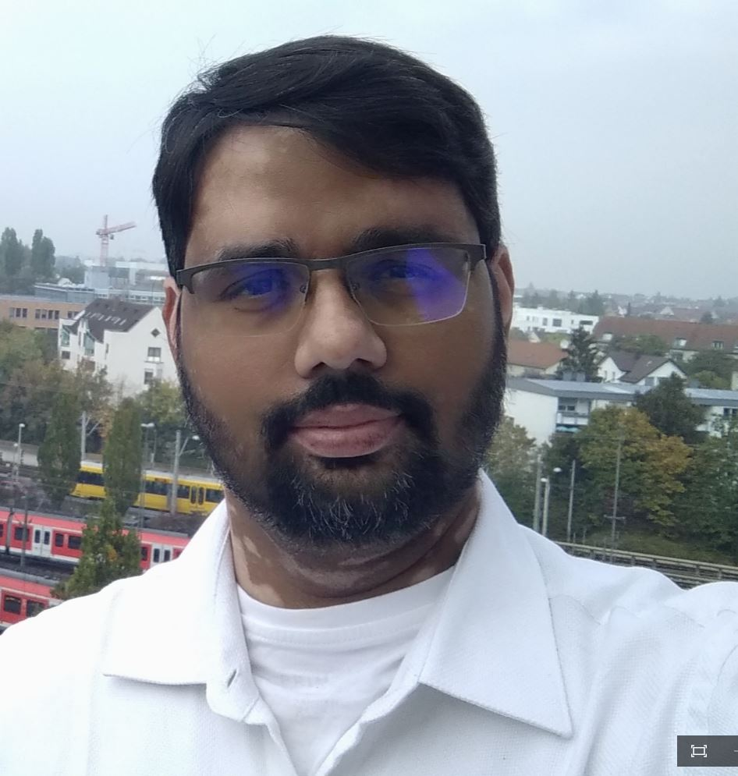
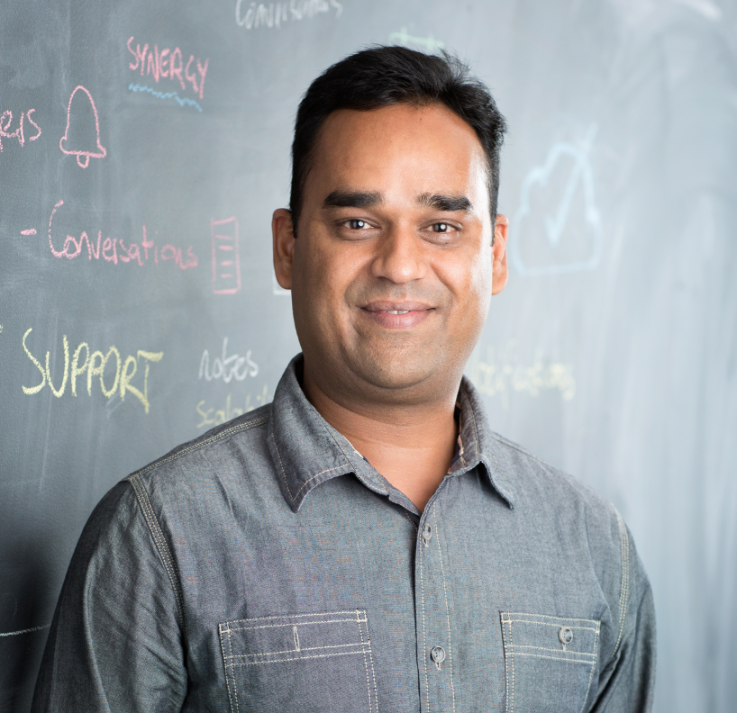
Team
Ankit Jain - Nasscom
Kumaresan S - Tafe
Pramod Chavan - AT&T
Prasad E - Mercedes-Benz
Pawan Bhadauria - Tact.ai

Slide 5
Answers to the Questionnaire (Data)
We chose this dataset because
Interest in rural social welfare
Socio-economic Impact
India is the agro based economy

Slide 6
Answers to the Questionnaire (Pre-processing)
We are getting data from varied sources (Excel, Images, Documents etc) & use following methods to pre-process it:
Extract & unify data in a single format
Support for multilingual data format
Data augmentation
Feature extraction based on pre-trained model

Slide 7
Answers to the Questionnaire (Algorithms)
Below are the salient points of our model:
Our model uses unsupervised clustering and then labeling the clusters for severity based on reference ideal village data
We will use the combination of autoencoder+K-means to create the effective clusters
We will use classification model to label the clusters in three classes – High Impact, Medium Impact, Low Impact

Slide 8
Answers to the Questionnaire (Expected End Results)
Clusters of villages having severity levels as High, Medium and Low Impact of droughts. This will be used by the Government to create the drought response strategy by prioritizing resources and reducing time to action.

Slide 9
Post Course
Plans to implement or take this forward after the course:
We will work on datasets of various governmental agencies/NGOs and evaluate the accuracy of our models and its impact.

Slide 10
Q & A

Slide 11
Thank you!

